Slide 1
System Panic
Presenters
Layla Hoey
Antony Pinto

Slide 2
Agenda
Poster
Enemy Artwork
Character Menu
Attribute Upgrade System
Gameplay Demo (More Music)

Slide 3
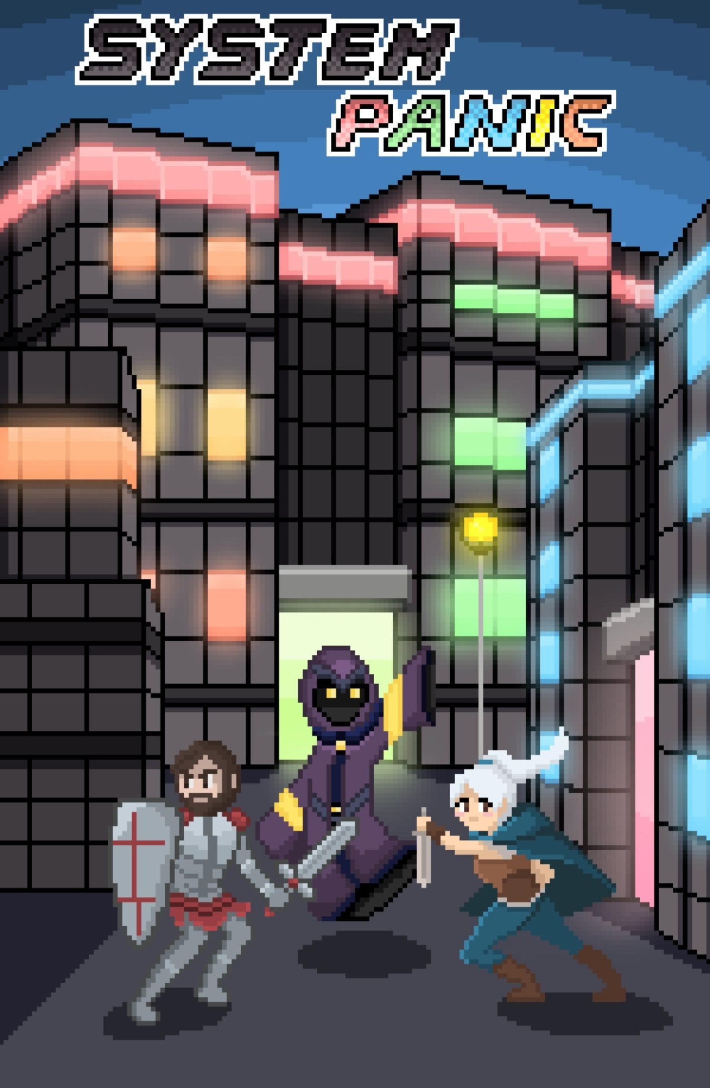

Poster
Special thanks to
Purrrfect Tactics’ own:
Bianca!!
Music
Special thanks to
Composer Shlinler Derenecourt!!
(Main Title)

Slide 4
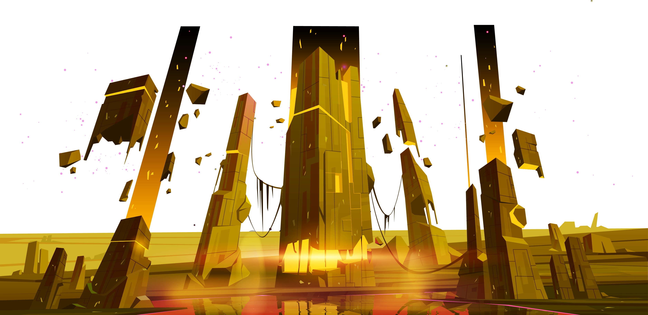
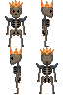
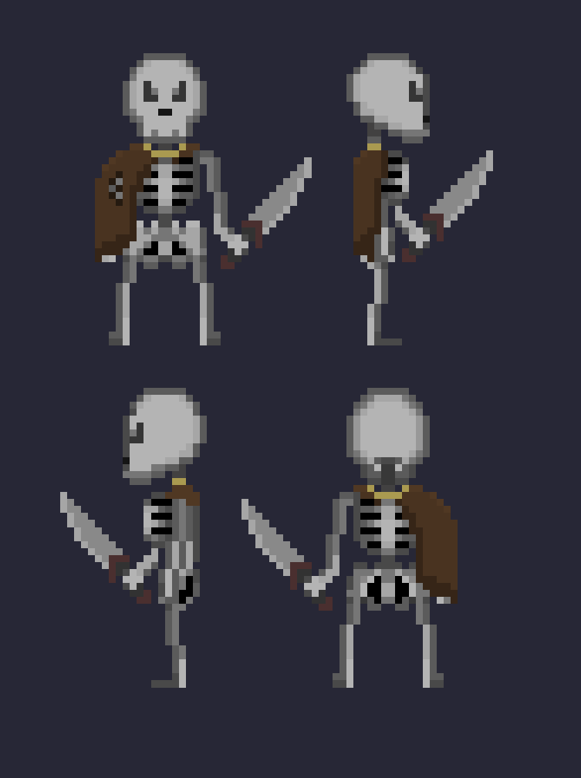
Art - Enemies
Skeleton King
Skeleton

Slide 5
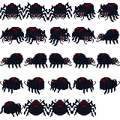
Art - Enemies
Spider

Slide 6
Intersection Updates
New Intersections made last week

Slide 7
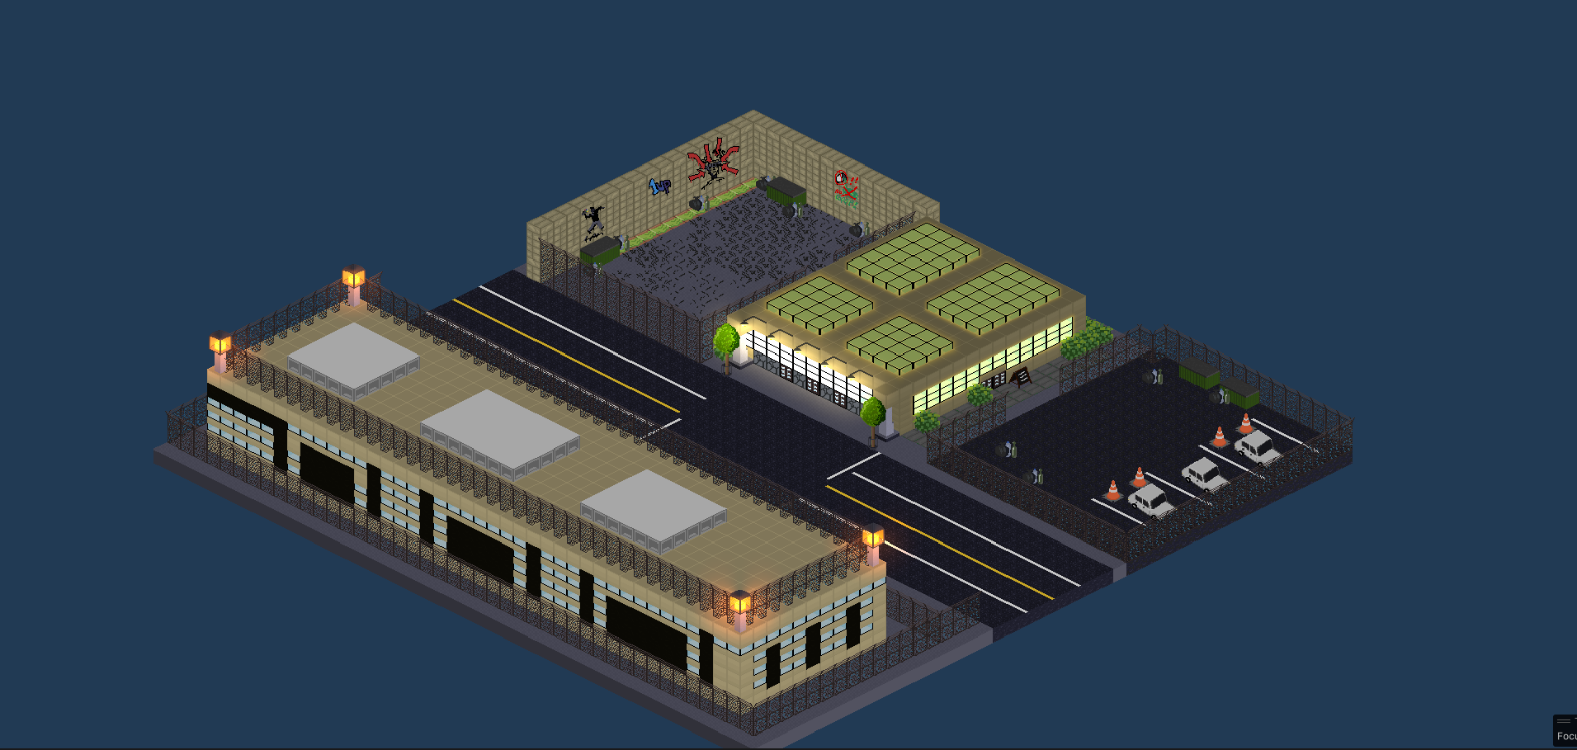
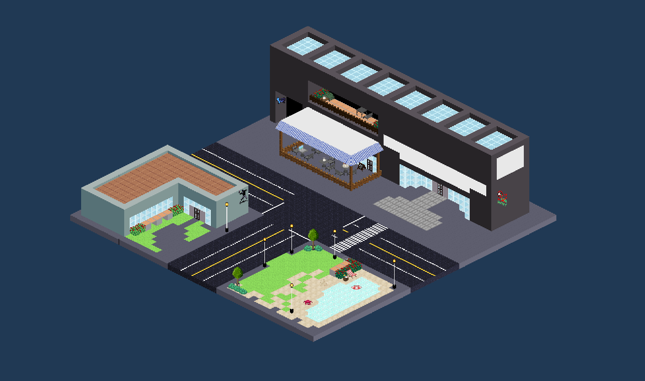
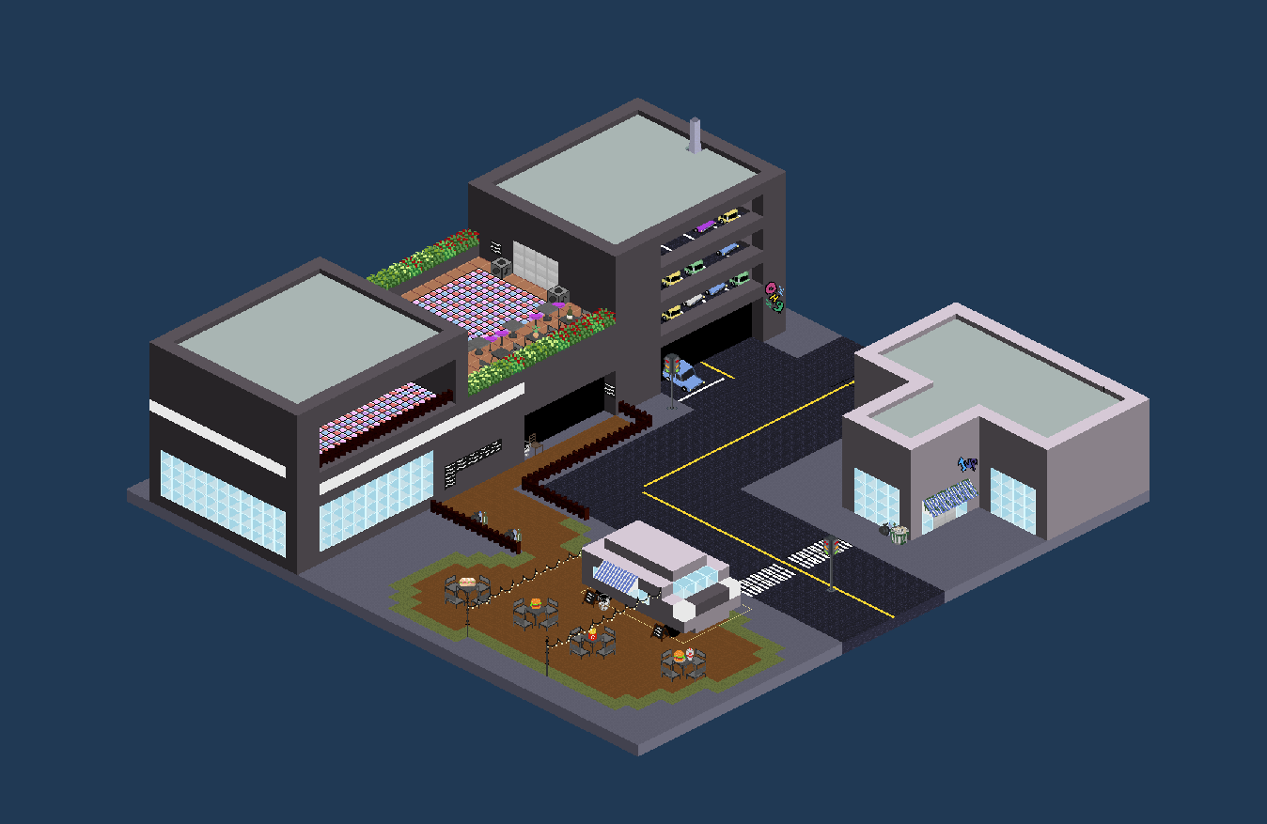
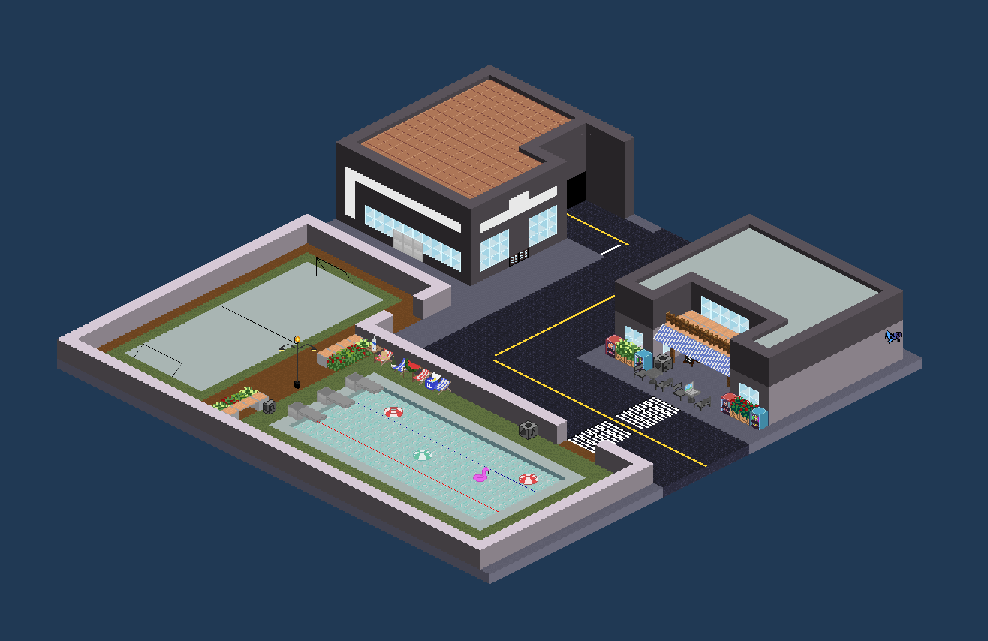

Slide 8
Dungeon Updates
New Dungeons made last week

Slide 9
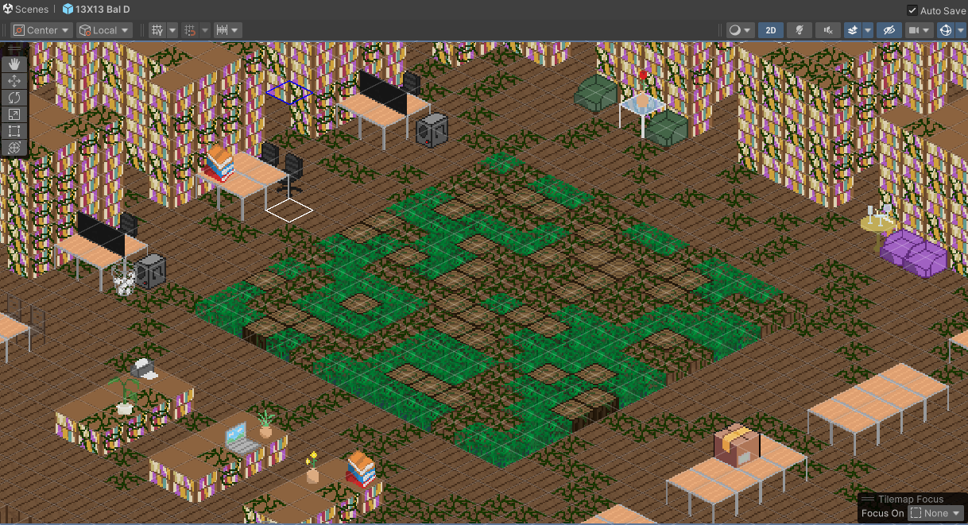
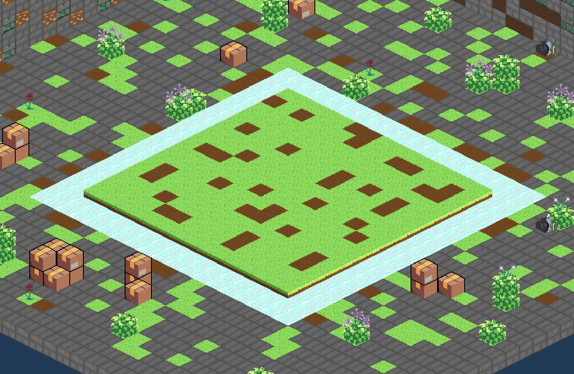
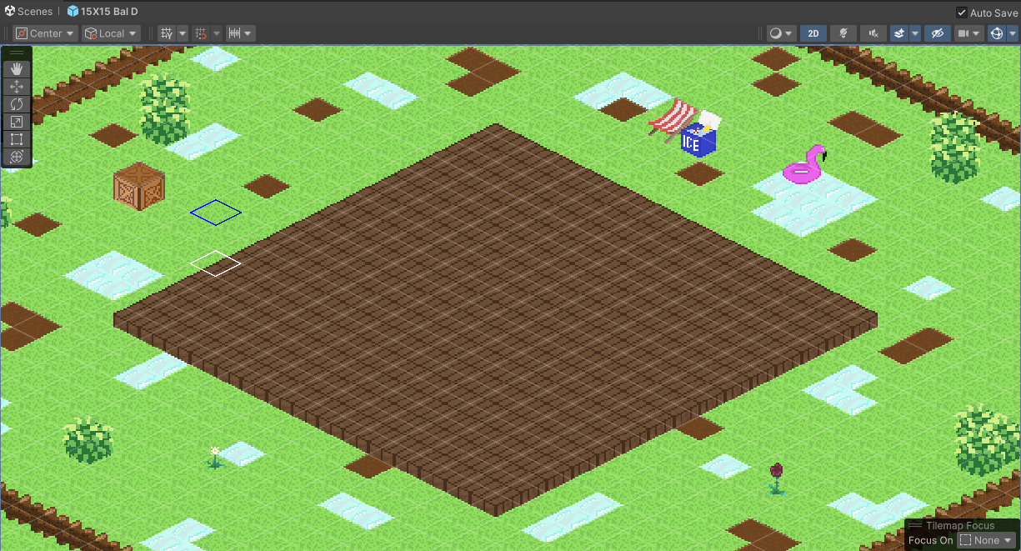
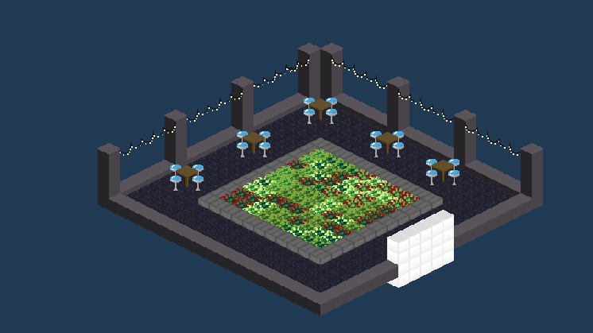

Slide 10
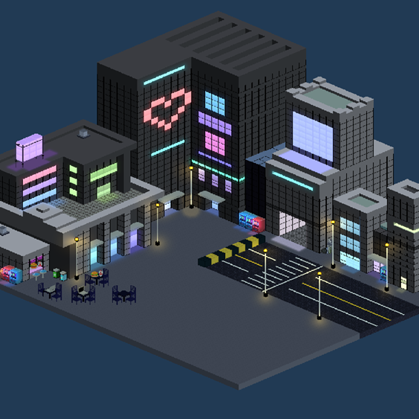
Multi-panel
Character Menu
Left Panel
Dropdown Panel Selection
Right Panel
View Attributes and Stats
Upgrade Attributes

Slide 11
Character Sheet / Equipment
Dropdown Swap
Here you can examine your equipment, or check in on your player’s overall experience and level progression, as well as $Credits$
Dropdown design allows for selecting a single panel and watching the effects any changes have on your stats.

Slide 12
Static Attributes / Stats Panel
Upgrade Mode
This panel is home to your most important character information:
your Combat stats!
Button to enter upgrade mode appears when the player has Attribute Points, allowing them to increase Attributes, as well as see the effects each will have on their Stats.

Slide 13
Gameplay
Showcases the general inner-loop of the game
Find a Dungeon that you’re willing to risk for the rewards
Attempt to best it!

Slide 14
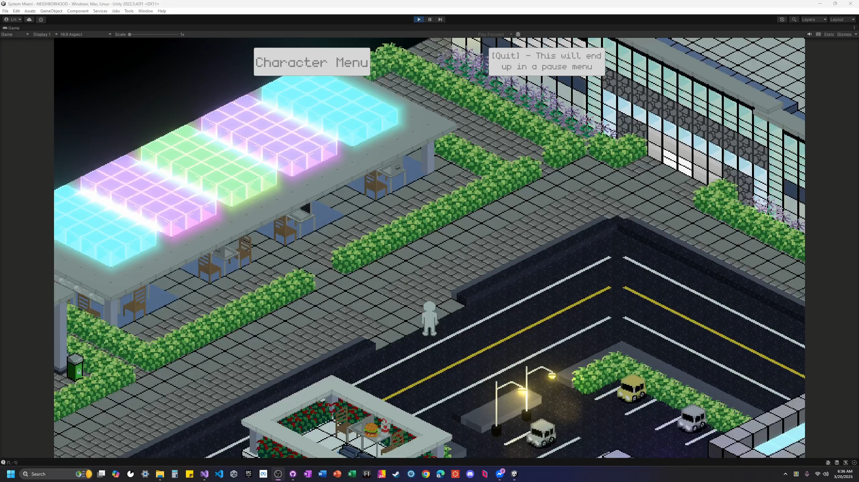

Slide 15
Up Next
We will be working tirelessly over the break to get the game ready to playtest!

Slide 16
Thanks!
Questions? Feedback?

